Slide 1
PG-AICON-Storage
Lameya Afroze
Shraddha Pawar
Nayela Tasnim Labonno
Indranil Ghosh

Slide 2
Outline
Problem statement
Current scenario
Architecture
Proposed scenario
Deciding Parameter

Slide 3
Problem Statement
Decide on storage applications
Model profiling scenarios decide on parameters (e.g., retention time, requests/s)
Implement profiling scenarios

Slide 4
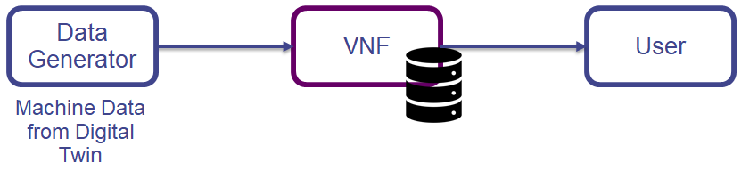
Current scenario
VNF uses the technologies of IT virtualization to virtualize entire classes of network node functions into building blocks these building blocks may make a chain together to work, to create communication services.

Slide 5
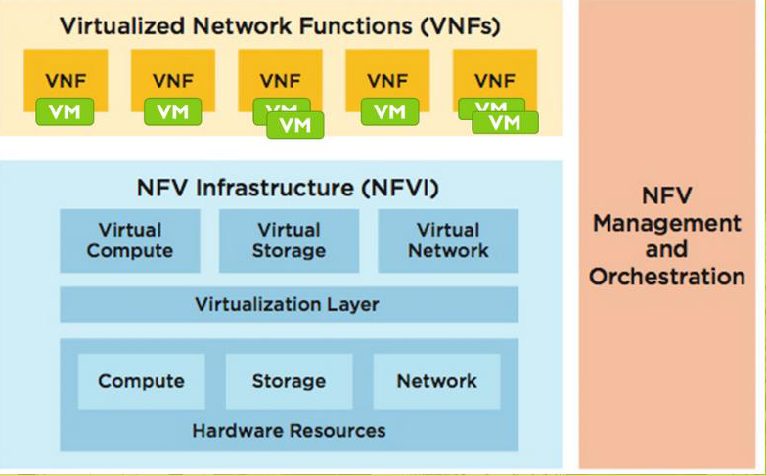
NFV Architecture

Slide 6
Proposed Scenario
Deciding Parameter is retention time
Data will be coming in alternative clock cycle.
After certain period of time data will be moved from input topic to a secondary queue. Again after same time delay the secondary queue messages will be consumed. And will be populated by the new data
Request will be coming in alternate clock cycle

Slide 7
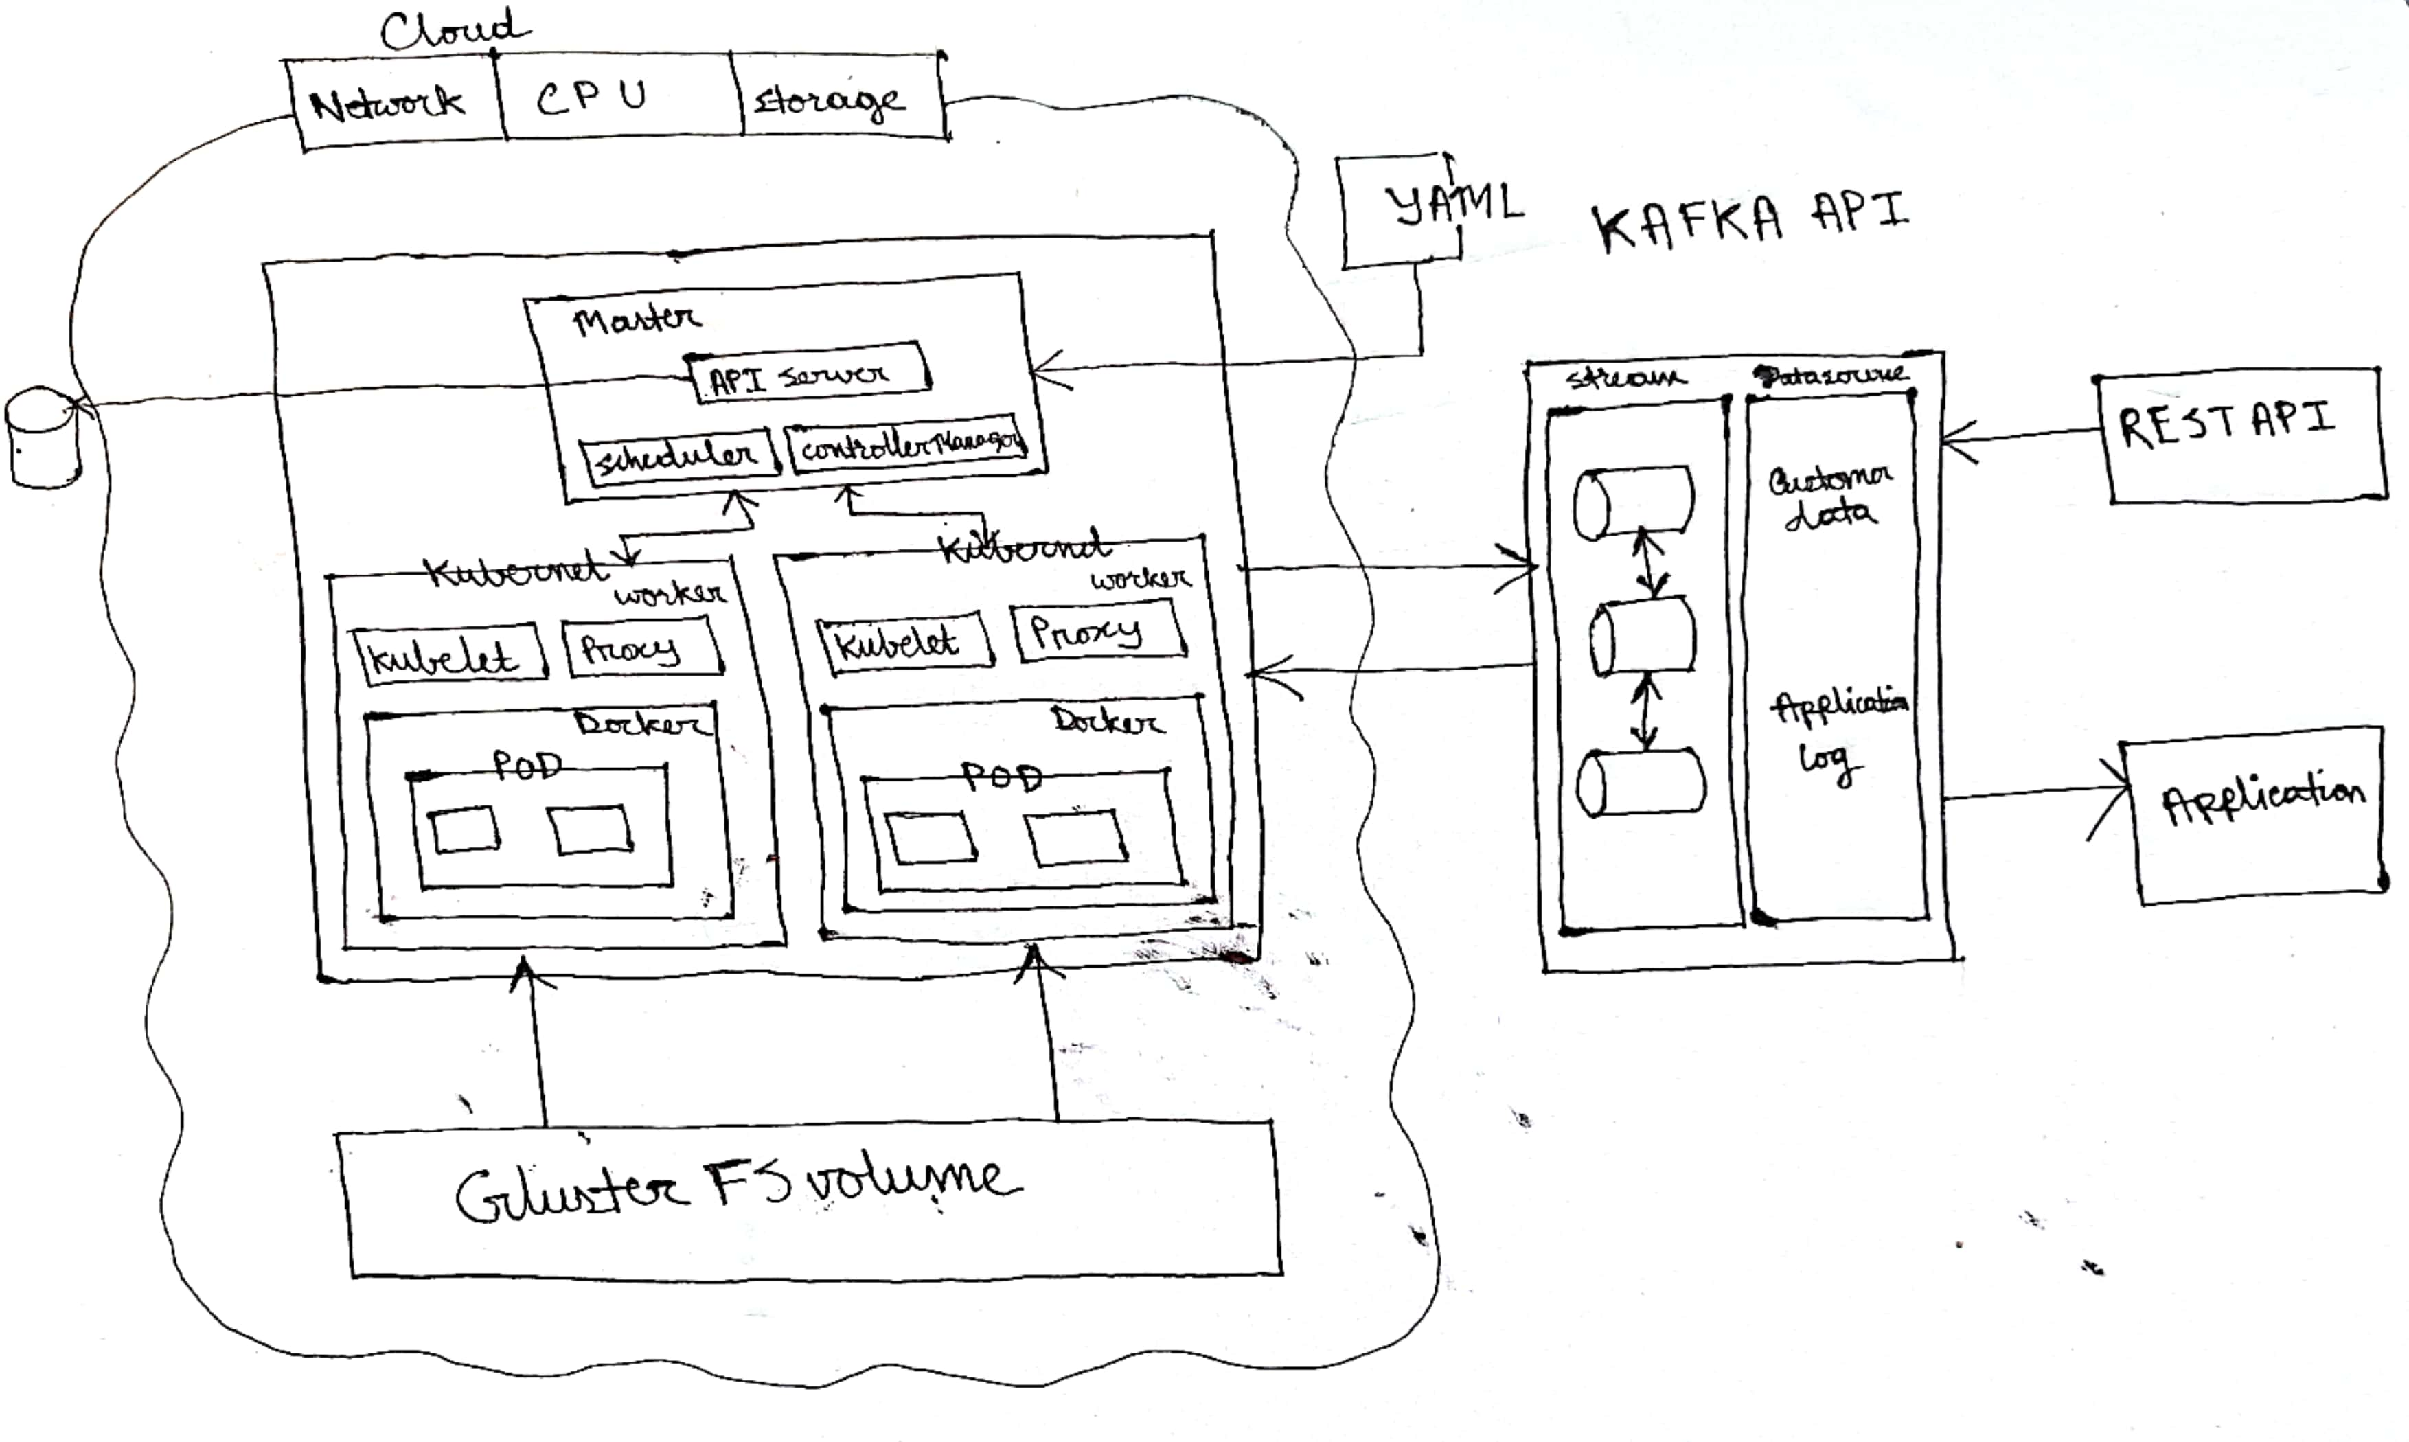

Slide 8
Thank You

